Slide 1
Switching

Slide 2

Figure 1 Switched network

Slide 3

Figure
2 Taxonomy of switched networks

Slide 4
CIRCUIT-SWITCHED NETWORKS
A circuit-switched network consists of a set of switches connected by physical links. A connection between two stations is a dedicated path made of one or more links. However, each connection uses only one dedicated channel on each link. Each link is normally divided into n channels by using FDM or TDM.
Topics discussed in this section:
Three Phases
Efficiency
Delay
Circuit-Switched Technology in Telephone Networks

Slide 5
CIRCUIT-SWITCHED NETWORKS
Points to be remembered: circuit-switched network
Takes place at the physical layer.
Before starting communication, the stations must make a reservation for the resources
to be used during the communication.
Resources: Channels, switch buffers, switch processing time, input-output port etc.
Data transferred between the two stations are not packetized (physical layer transfer
of the signal). The data are a continuous flow sent by the source station and received
by the destination station, although there may be periods of silence.
There is no addressing involved during data transfer. The switches route the data
based on their occupied band (FDM) or time slot (TDM). There is end to end addressing scheme during the set up phase.

Slide 6

Note
A circuit-switched network is made of a set of switches connected by physical links, in which each link is
divided into n channels.

Slide 7

Figure 3: A trivial circuit-switched network

Slide 8
Note
In circuit switching, the resources need to be reserved during the setup phase;
the resources remain dedicated for the entire duration of data transfer until the teardown phase.

Slide 9
Example 1
As a trivial example, let us use a circuit-switched network to connect eight telephones in a small area. Communication is through 4-kHz voice channels. We assume that each link uses FDM to connect a maximum of two voice channels. The bandwidth of each link is then 8 kHz. Figure 8.4 shows the situation. Telephone 1 is connected to telephone 7; 2 to 5; 3 to 8; and 4 to 6. Of course the situation may change when new connections are made. The switch controls the connections.

Slide 10

Figure 4 :Circuit-switched network used in Example 1

Slide 11
Example 2
As another example, consider a circuit-switched network that connects computers in two remote offices of a private company. The offices are connected using a T-1 line leased from a communication service provider. There are two 4 × 8 (4 inputs and 8 outputs) switches in this network. For each switch, four output ports are folded into the input ports to allow communication between computers in the same office. Four other output ports allow communication between the two offices. Figure 8.5 shows the situation.

Slide 12

Figure 5 Circuit-switched network used in Example 2

Slide 13
CIRCUIT-SWITCHED NETWORKS
Connection Set up.
Data Transfer
Connection Teardown

Slide 14
CIRCUIT-SWITCHED NETWORKS
Efficiency
Delay

Slide 15

Figure 7 Delay in a circuit-switched network

Slide 16
Delay circuit-switched network
Delay caused by the setup is the sum of four parts:
The propagation time of the source computer request (slope of the first gray box)
The request signal transfer time (height of the first gray box),
The propagation time of the acknowledgment from the destination computer (slope of the second gray box)
The signal transfer time of the acknowledgment
(height of the second gray box).

Slide 17
Delay circuit-switched network
Delay caused by the setup is the sum of four parts:
The delay due to data transfer is the sum of two parts:
The propagation time (slope of the colored box) and
Data transfer time (height of the colored box), which can be very long.
The third box shows the time needed to tear down the circuit. We have shown the case in which the receiver requests disconnection, which creates the maximum delay.

Slide 18
Note
Switching at the physical layer in the traditional telephone network uses
the circuit-switching approach.

Slide 19
Packet Switched Network
Messages need to be divided into packets of fixed or variable size.
Resources are allocated on demand.
No reserve bandwidth on the links.
No scheduled processing time.

Slide 20
Packet Switched Network
There are two types of packet switched network.
Datagram Networks
Virtual Circuit Networks

Slide 21
DATAGRAM NETWORKS
In data communications, we need to send messages from one end system to another. If the message is going to pass through a packet-switched network, it needs to be divided into packets of fixed or variable size. The size of the packet is determined by the network and the governing protocol.
Topics discussed in this section:
Routing Table
Efficiency
Delay
Datagram Networks in the Internet

Slide 22
Note
In a packet-switched network, there
is no resource reservation;
resources are allocated on demand.

Slide 23

Figure 8 A datagram network with four switches (routers)

Slide 24

Figure 9 Routing table in a datagram network

Slide 25
Note
A switch in a datagram network uses a routing table that is based on the destination address.

Slide 26
Note
The destination address in the header of a packet in a datagram network
remains the same during the entire journey of the packet.

Slide 27
Note
Efficiency of a datagram Network is better than that of a circuit switched network; resources are allocated when there are packets to be transferred.

Slide 28
Note
There may be greater delay in a datagram network than in a virtual circuit network. Although there are no set up and tear down phase, each packet may experience a wait at a switch before it is forwarded.

Slide 29

Figure 10 Delay in a datagram network

Slide 30
Note
In previous example the packet travels through two switches. There are 3 transmission time(3T), three propagation delays, and two waiting times(w1+w2). Ignoring processing time, the total delay is:

Slide 31
Note
Switching in the Internet is done by using the datagram approach
to packet switching at
the network layer.

Slide 32
Datagram Network
Advantages:
Call setup phase is avoided (for transmission of a few packets, datagram will be faster).
Because it is more primitive, it is more flexible.
Congestion/failed link can be avoided (more reliable).
Problems:
Packets may be delivered out of order.
If a node crashes momentarily, all of its queued packets are lost.

Slide 33
VIRTUAL-CIRCUIT NETWORKS
A virtual-circuit network is a cross between a circuit-switched network and a datagram network. It has some characteristics of both.
Topics discussed in this section:
Addressing
Three Phases
Efficiency
Delay
Circuit-Switched Technology in WANs

Slide 34
Characteristics of Virtual Circuit Network
Set up phase, teardown phase, data transfer phase like circuit switched network.
Resources can be allocated during the set up phase as in circuit switched network or on demand as in a datagram network.
As in a datagram network, data are packetized and each packet carries an address in the header.
As in a circuit switched network all packets follow the same path established during the connection.
Normally implemented in the data link layer.

Slide 35

Figure 11 Virtual-circuit network

Slide 36
Addressing
Two types of addressing:
Global
A source or a destination needs to have a global address.
Local (Virtual circuit identifier)
The identifier that is actually used for data transfer is called virtual circuit identifier (VCI) or the label.

Slide 37

Figure 12 Virtual-circuit identifier

Slide 38

Figure 13 Switch and tables in a virtual-circuit network (data transfer phase)

Slide 39

Figure 14 Source-to-destination data transfer in a virtual-circuit network
(set up phase)

Slide 40

Figure 15 Setup request in a virtual-circuit network

Slide 41

Figure 16 Setup acknowledgment in a virtual-circuit network

Slide 42
Tear down phase
In this phase, source A after sending all frames to B, sends a special frame called tear down request. Destination B responds with a tear down confirmation frame. All switches delete the corresponding entry from their tables.

Slide 43
Note
In virtual-circuit switching, all packets belonging to the same source and
destination travel the same path;
but the packets may arrive at the destination with different delays
if resource allocation is on demand.

Slide 44

Figure 17 Delay in a virtual-circuit network

Slide 45
Note
Switching at the data link layer in a switched WAN is normally
implemented by using
virtual-circuit techniques.

Slide 46
Virtual Circuit versus Datagram Packet Switching Network
Key features of the virtual circuit packet switching approach is as follows:
Node need not decide route
More difficult to adopt to congestion
Maintains sequence order
All packets are sent through the same predetermined route.
key features of the datagram packet switching are as follows:
Each packet is treated independently
Call set up phase is avoided
Inherently more flexible and reliable

Slide 47
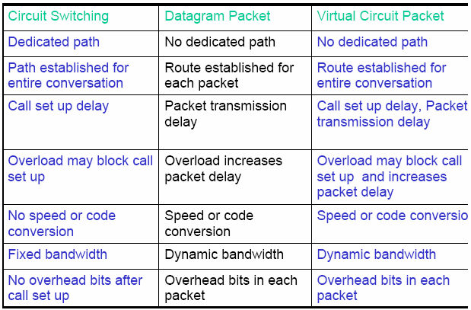
Comparison of three different techniques

Slide 48
STRUCTURE OF A SWITCH
We use switches in circuit-switched and packet-switched networks. In this section, we discuss the structures of the switches used in each type of network.
Topics discussed in this section:
Structure of Circuit Switches
Structure of Packet Switches

Slide 49
Circuit Switch Components
Digital Switch
  Provide transparent signal path between devices
Network Interface
Control Unit
  Establish connections
    Generally on demand
    Handle and acknowledge requests
    Determine if destination is free
    construct path
  Maintain connection
  Disconnect

Slide 50
Space division Switch
Developed for analog environment
Separate physical paths
Crossbar switch
  Number of crosspoints grows as square of number of stations
  Loss of crosspoint prevents connection
  Inefficient use of crosspoints
    All stations connected, only a few crosspoints in use
  Non-blocking

Slide 51

Figure 18 Crossbar switch with three inputs and four outputs

Slide 52
Multistage Switch
Reduced number of crosspoints
More than one path through network
  Increased reliability
More complex control
May be blocking

Slide 53

Figure 19 Multistage switch

Slide 54
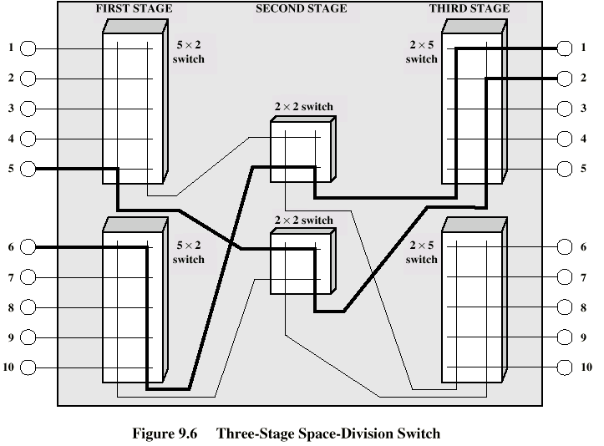
Figure 20 Multistage switch

Slide 55
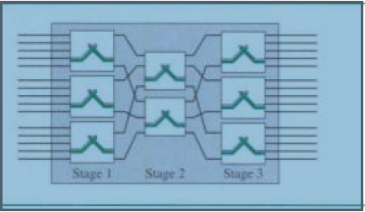
Figure 21 Multistage switch
Multistage
1st stage & final stages: 3 switches
Middle stage: 2 switches

Slide 56
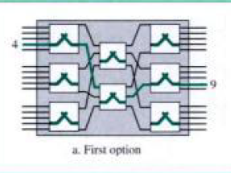
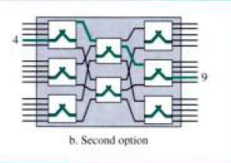
Figure 22 Multiple paths

Slide 57
Note
In a three-stage switch, the total
number of crosspoints is
2kN + k(N/n)²
which is much smaller than the number of crosspoints in a single-stage switch (N²).

Slide 58
Blocking and Non-blocking
Blocking
  A network is unable to connect stations because all paths are in use
  A blocking network allows this
  Used on voice systems
    Short duration calls
Non-blocking
  Permits all stations to connect (in pairs) at once
  Used for some data connections

Slide 59
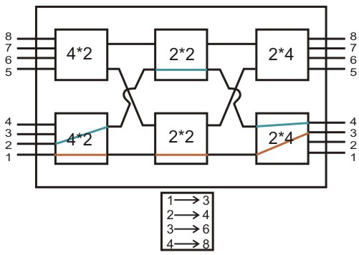
Figure 22 Blocking Nature of Switch

Slide 60
Example 3
Design a three-stage, 200 × 200 switch (N = 200) with
k = 4 and n = 20.
Solution
In the first stage we have N/n or 10 crossbars, each of size 20 × 4. In the second stage, we have 4 crossbars, each of size 10 × 10. In the third stage, we have 10 crossbars, each of size 4 × 20. The total number of crosspoints is 2kN + k(N/n)², or 2000 crosspoints. This is 5 percent of the number of crosspoints in a single-stage switch (200 × 200 = 40,000).

Slide 61
Note
According to the Clos criterion:
n = (N/2)^{1/2}
k > 2n – 1
Crosspoints ≥ 4N [(2N)^{1/2} – 1]

Slide 62
Example 4
Redesign the previous three-stage, 200 × 200 switch, using the Clos criteria with a minimum number of crosspoints. Error: 20X20
Solution
We let n = (200/2)^{1/2}, or n = 10. We calculate k = 2n − 1 = 19. In the first stage, we have 200/10, or 20, crossbars, each with 10 × 19 crosspoints. In the second stage, we have 19 crossbars, each with 20 × 20 crosspoints. In the third stage, we have 20 crossbars each with 19 × 10 crosspoints. The total number of crosspoints is 20(10 × 19) + 19(20 × 20) + 20(19 ×10) = 15200.

Slide 63
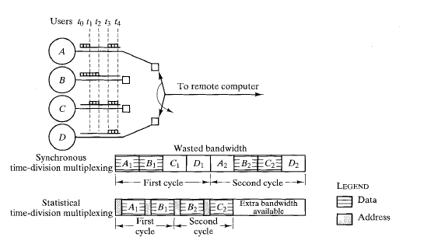
Figure 23 Statistical versus synchronous time division multiplexing

Slide 64
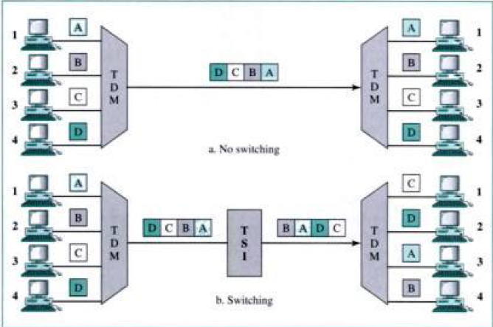
Figure 23 Time-division multiplexing without and with a time slot interchange

Slide 65

Figure 24 Time-slot interchange

Slide 66
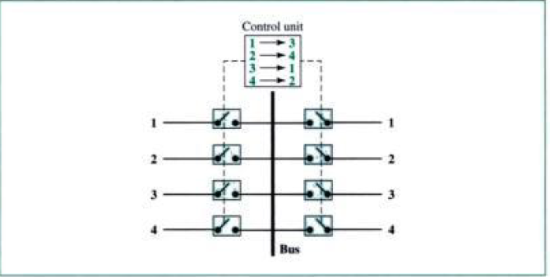
Figure 25 TDM Bus

Slide 67

Figure 26 Time-space-time switch

Slide 68

Figure 27 Packet switch components

Slide 69

Figure 28 Input port

Slide 70

Figure 29 Output port

Slide 71
Contention – Output Port Buffering
Problem
– Some packets may be destined for the same output port
• Solutions
– One packet gets sent first
– Other packets get delayed or dropped
• Delaying packets requires buffering
– Buffers are finite, so we may still have to drop
– Buffering at input ports
• Increases, adds false contention
• Sometimes necessary
– Buffering at output ports
– Buffering inside switch

Slide 72
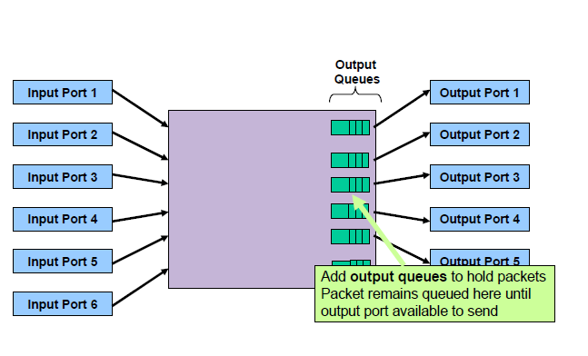
Switch Design

Slide 73
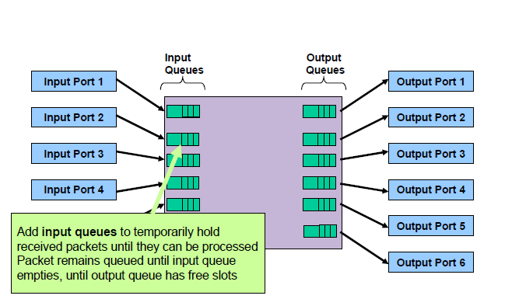
Switch Design

Slide 74
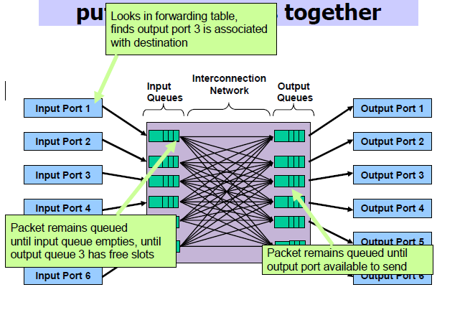
Switch Design

Slide 75
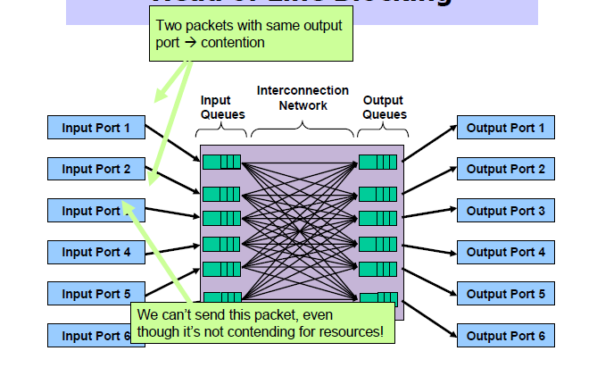
Switch Design
Line Blocking

Slide 76
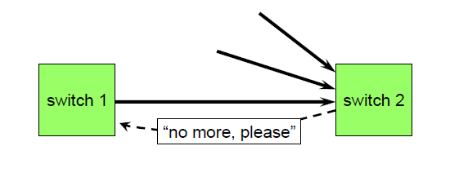
Contention- Back Pressure
Let the receiver tell the sender to slow down
-propagation delay requires that the receiver reacts before the buffer is full.
-Typically used in the networks with small propagation delay.

Slide 77
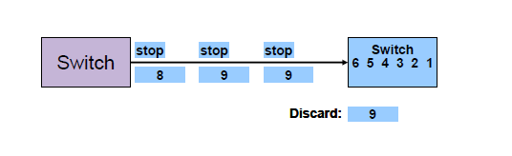
Contention- Back Pressure
Propagation delay that switch 2 exert backpressure at high water mark rather when buffer completely full. Backpressure is typically only used in networks with small propagation delay.

Slide 78
Switch Design Goals
High throughput
-- Number of packets a switch can forward per second
High Scalability
--How many input/output ports can it connect
Low cost
-- Per port monetary cost

Slide 79
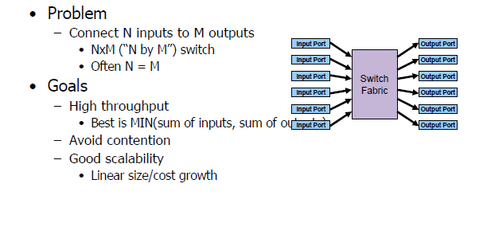
Special Purpose Switches

Slide 80
Switch Design
Ports handle complexity
-- Forwarding Decisions
-- Buffering
Simple fabric
--Moves packets from inputs to outputs
--May have a small amount of internal buffering

Slide 81
Switch Design Goals
Throughput
-- Main problem is contention
-- Need a good traffic model
-Arrival time
-destination port
-packet length

Slide 82
Switch Design Goals
Contention
-- Avoid contention through intelligent buffering
-- Use output buffering when possible
--Apply back pressure through switch fabric
--Improve input buffering through non-FIFO buffers
-Reduce head of line blocking
--Drop packets when input buffers overflow.

Slide 83
Switch Design Goals
Scalability
-- O(N) ports
-- Port design complexity O(N) gives O(N^2) for the entire switch
-- Port design complexity O(1) gives O(N) for the entire switch

Slide 84
Self-Routing Fabrics
Idea
-- Use source routing on “network” in switch
-- Input Port attaches output port number as header
-- Fabric routes packets based on output port
Types
--Banyan Network
--Batcher-Banyan Network
--Sunshine Switch

Slide 85
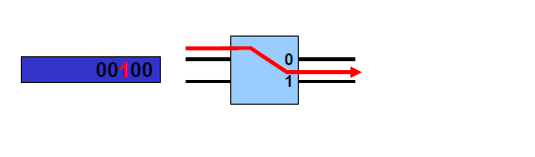
Banyan Network
A network of 2 X 2 switches
-- Each element routes to output 0 or 1 based on packet header.
-- A switching element at stage i looks at bit i in the header

Slide 86
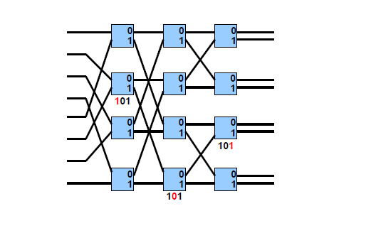
Banyan Network

Slide 87
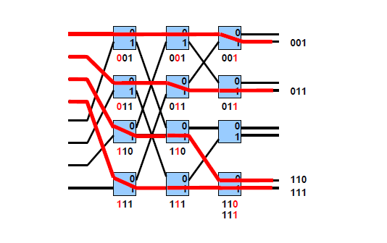
Banyan Network

Slide 88
Banyan Network
Perfect Shuffle
-- N inputs require log₂N stages of N/2 switching elements
-- Complexity on order of N log₂N
Collisions
--If two packets arrive at the same switch destined for the same output port, a collision will occur.
--If all the packets are sorted in ascending order upon arrival to a banyan network, no collision will occur.

Slide 89
What is Shuffle?
000
000
000
000
=0
001
001
001
001
=1
010
010
010
010
=2
011
011
011
011
=3
100
100
100
100
=4
101
101
101
101
=5
110
110
110
110
=6
111
111
111
111
=7
(a) Perfect shuffle
(b) Inverse perfect shuffle
shuffle interconnection
S(a_{n-1} a_{n-2} … a₁ a₀) = (a_{n-2} a_{n-3} … a₀ a_{n-1} )

Slide 90
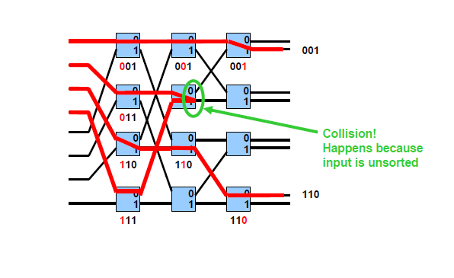
Collision in Banyan Network

Slide 91

Figure 30 A banyan switch

Slide 92

Figure 31 Examples of routing in a banyan switch

Slide 93

Figure 32 Batcher-banyan switch

Slide 94

Batcher- Banyan Network
Performs merge sort
A network of 2 X 2 switches
-- Each element routes to output 0 or 1 based on packet header.
-- A switching element at stage i looks at bit i in the header.
--Two types of switches
-UP switch
--sends higher number to top output (0)
-Down switch
-- sends higher number to top output (1)

Slide 95
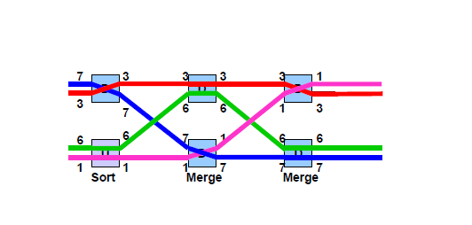
Batcher Network

Slide 96
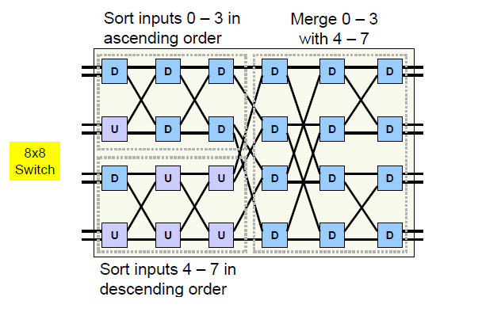
Batcher Network

Slide 97
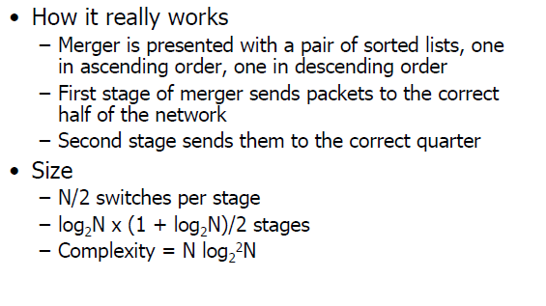
Batcher Network

Slide 98
Example of Self Routing
Cell destined for output port 4 (= 100 )
2
0
0
1
4
1
2
2
3
3
4
4
5
5
6
6
7
7

Slide 99
Example of Self Routing
Cell destined for output port 4 (= 100 )
2
0
0
1
4
1
2
2
3
3
4
4
5
5
6
6
7
7

Slide 100
Example of Self Routing
Cell destined for output port 4 (= 100 )
2
0
0
1
1
2
2
3
3
4
4
4
5
5
6
6
7
7

Slide 101
Example of Self Routing
Cell destined for output port 4 (= 100 )
2
0
0
1
1
2
2
3
3
4
4
4
5
5
6
6
7
7

Slide 102
Example of Self Routing
Cell destined for output port 4 (= 100 )
2
0
0
1
1
2
2
3
3
4
4
4
5
5
6
6
7
7

Slide 103
Example of Self Routing
Cell destined for output port 4 (= 100 )
2
0
0
1
1
2
2
3
3
4
4
4
5
5
6
6
7
7

Slide 104
Example of Self Routing
Cell destined for output port 4 (= 100 )
2
0
0
1
1
2
2
3
3
4
4
5
5
6
4
6
7
7

Slide 105
Example of Self Routing
Cell destined for output port 4 (= 100 )
2
0
0
1
1
2
2
3
3
4
4
5
5
6
6
7
4
7

Slide 106
Example of Self Routing
Cell destined for output port 4 (= 100 )
2
0
0
1
1
2
2
3
3
4
4
5
5
6
6
7
4
7

Slide 107
Example of Self Routing
Cell destined for output port 4 (= 100 )
2
0
0
1
1
2
2
3
3
4
4
5
5
6
4
6
7
7

Slide 108
Example of Self Routing
Cell destined for output port 4 (= 100 )
2
0
0
1
1
2
2
3
3
4
4
5
4
5
6
6
7
7

Slide 109
Example of Self Routing
Cell destined for output port 4 (= 100 )
2
0
0
1
1
2
2
3
3
4
4
4
5
5
6
6
7
7

Slide 110
Multiple Concurrent Paths
0
0
1
5
1
2
2
3
7
3
4
4
5
5
6
6
7
7

Slide 111
Multiple Concurrent Paths
0
0
1
5
1
2
2
3
7
3
4
4
5
5
6
6
7
7

Slide 112
Multiple Concurrent Paths
0
0
1
1
2
2
3
3
4
5
4
5
5
6
7
6
7
7

Slide 113
Multiple Concurrent Paths
0
0
1
1
2
2
3
3
4
5
4
5
5
6
6
7
7
7

Slide 114
Multiple Concurrent Paths
0
0
1
1
2
2
3
3
4
5
4
5
5
6
6
7
7
7

Slide 115
Multiple Concurrent Paths
0
0
1
1
2
2
3
3
4
4
5
5
5
6
6
7
7
7

Slide 116
Multiple Concurrent Paths
0
0
1
5
1
2
2
3
7
3
4
4
5
5
6
1
6
7
7

Slide 117
Multiple Concurrent Paths
0
0
1
5
1
2
2
3
7
3
4
4
5
5
6
1
6
7
7

Slide 118
Multiple Concurrent Paths
0
0
1
1
2
2
3
1
3
4
5
4
5
5
6
7
6
7
7

Slide 119
Multiple Concurrent Paths
0
0
1
1
2
1
2
3
3
4
5
4
5
5
6
6
7
7
7

Slide 120
Multiple Concurrent Paths
0
0
1
1
1
2
2
3
3
4
5
4
5
5
6
6
7
7
7

Slide 121
Multiple Concurrent Paths
0
0
1
1
1
2
2
3
3
4
4
5
5
5
6
6
7
7
7

Slide 122
Output Port Contention
Up to now, all examples have worked wonderfully because each incoming cell was destined to a different output port
What happens if more than one cell destined to same output port?
Answer: output port contention
Result: cell loss in a bufferless network
Alternatives: buffering, deflection routing, recirculation, tandem banyans, ...

Slide 123
Output Port Contention
0
0
1
4
1
2
2
3
3
4
4
5
5
6
4
6
7
7

Slide 124
Output Port Contention
0
0
1
4
1
2
2
3
3
4
4
5
5
6
6
7
4
7

Slide 125
Output Port Contention
0
0
1
1
2
2
3
3
4
4
4
5
5
6
6
7
4
7

Slide 126
Output Port Contention
0
0
1
1
2
2
3
3
4
4
4
5
5
6
4
6
7
7

Slide 127
Output Port Contention
0
0
1
1
2
2
3
3
4
4
4
5
4
5
6
6
7
7

Slide 128
Output Port Contention
0
0
1
1
2
2
3
3
4
4
5
5
6
6
7
7

Slide 129
Output Port Contention
0
0
1
1
2
2
3
3
4
4
4
4
5
5
6
6
7
7

